Slide 1

ML-Integrated Wireless Systems
By: Jemii, Noah, Megan, Aleksyah

Slide 2
01
Literature Review

Slide 3

01
02
Introduction
Machine learning (ML) has grown from $1.58 billion in 2017 to an expected $20.83 billion by 2024
Increased reliance on ML exposes these wireless systems to adversarial attacks that degrade performance and compromise network functionality.

Slide 4
Topic 1: Adversarial Attacks
Adversarial attacks are techniques designed to deceive, exploit and interrupt the performance of ML wireless systems (Boesch, 2023)
Attacks have evolved from sending jamming signals to overwhelm the communication system to becoming adversaries that send out small perturbation signals
Some adversarial attacks can successfully target vulnerable ML wireless systems without prior knowledge of the system, known as a black-box attack

Slide 5
Topic 2: Data Poisoning Attacks
When data is corrupted or changed in the training dataset compromising the performance of a dataset
Data poisoning attacks can lead to incorrect signal classification resulting in incorrect signal modulation and disrupted communication
Data Poisoning attacks are a common vulnerability of machine learning models

Slide 6
Topic 3: Machine Learning Vulnerabilities in Signal Classification
Integrating ML into wireless systems has advanced signal classification, enabling precise predictions but also raising security and reliability concerns
Data bias from flawed training sets can skew predictions, impacting system performance and can lead to discriminatory outcomes in ML models (Mehrabi et al. (2021) and Zhang et al. (2019))
Research by Khazane et al. (2024) and Freitas (2023) indicates that adversarial attacks on models like GNN can decrease classification accuracy by over 30%

Slide 7
Gaps in Research
While ML has enhanced signal classification and modulation in wireless systems, real-world challenges reveal critical defence gaps that adversarial attacks can exploit
Current defences often fall short in unpredictable environments, leaving systems exposed

Slide 8


—Research Question
“What hidden vulnerabilities exist in ML-integrated wireless systems, and how can we address them to build more secure and resilient systems?”

Slide 9
02
MatLab Demo

Slide 10
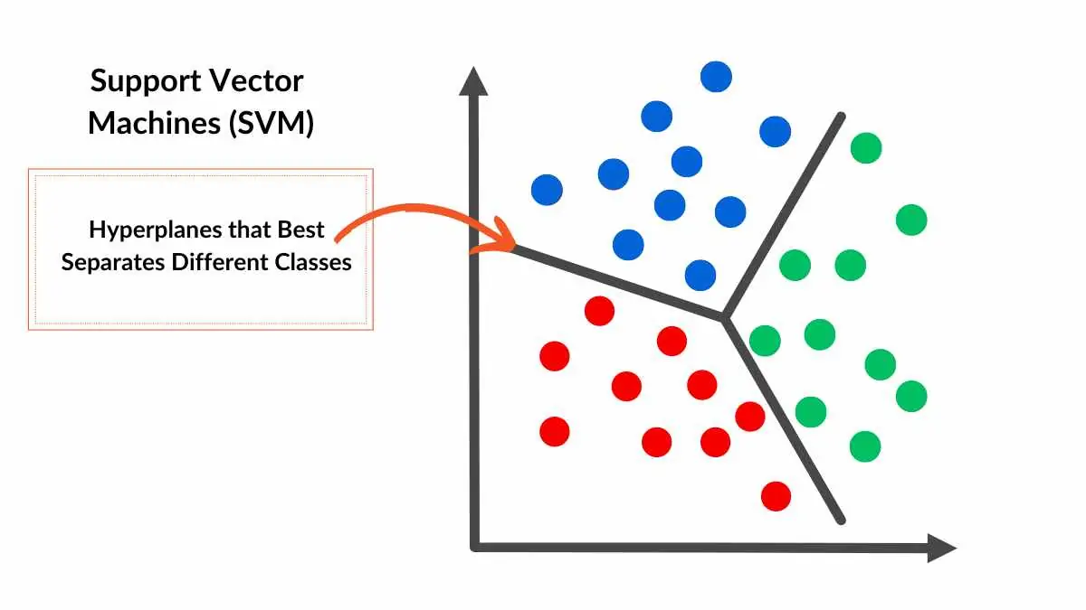
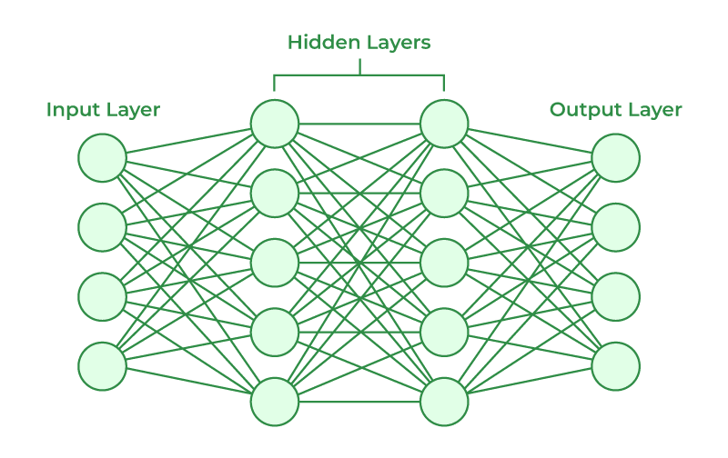
Classifiers
The MATLAB Demo features two supervised learning classifiers
Support Vector Machine - Traditional machine learning
Neural Network - Deep learning Technique

Slide 11

MatLab Function
These models simulate 5G wireless signals while examining the vulnerabilities that face wireless systems integrating machine learning
The attacks covered include:
Adversarial Attacks
Data Poisoning Attacks

Slide 12
Results
SVM
High precision in classifying adversarial inputs
Performance is less adaptive to noise
Vulnerable to data poisoning accuracy dropping by 50%
Struggles to detect anomalies with static thresholding
Well suited for small datasets
NN
More resilient to Data poisoning achieving 80% accuracy
Robust model with high adaptable especially with optimized epochs
Higher recall finding more adversarial points and subtle attacks

Slide 13
03
Research Report

Slide 14

Discussion
MATLAB simulations reveal how adversarial attacks compromise the reliability of ML-based wireless systems, exposing critical security challenges.
There is an urgent need for adaptable, noise-resistant ML strategies to secure dynamic networks like 5G and IoT against evolving adversarial threats.
Vulnerabilities in ML models, like susceptibility to signal jamming, can lead to miscommunication and classification errors that impact system performance.
Traditional defences, including anomaly detection and adversarial training, often fail in unpredictable, noisy environments, especially for models like SVMs and basic neural networks.

Slide 15
Recommendations

Slide 16
Key Threats and Solutions
1. Adversarial Attacks
- Threat: Attackers modify signals to mislead ML models, degrading performance
- Solution:
- Advanced adversarial training with diverse disruptions
- Dynamic, real-time model adaptation to emerging threats (crucial for 5G, IoT)
2. Data Poisoning
- Threat: In federated learning, poisoned data from a single device can spread across the network
- Solution:
- Enhanced data validation using differential privacy to add controlled noise
- Hybrid validation with traditional checks + ML-based anomaly detection for real-time response
3. Noise Interference
- Problem: Noise causes misclassifications, undermining reliability
- Solution:
- Develop noise-resistant algorithms with SNR optimisation and advanced filtering
- Use Graph Neural Networks (GNNs) to improve classification under interference
4. Signal Classification & Modulation Detection
- Threat: Adversarial attacks disrupt signal interpretation at every layer
- Solution:
- Use Autoencoders to compress data and filter out non-standard inputs
- Residual Neural Networks to maintain accuracy under interference
- Implement these techniques at the physical layer for enhanced signal classification accuracy
5. Adaptive Anomaly Detection
- Issue: Conventional detection fails in dynamic environments
- Solution:
- Use adaptive anomaly detection with reinforcement learning for real-time response
- Adjust detection to changing noise levels and network conditions for greater sensitivity

Slide 17
Summary
1. ML Enhancements and New Vulnerabilities
- ML integration in wireless systems boosts signal classification, modulation, and network efficiency.
- However, it exposes systems to evolving threats like adversarial attacks and data poisoning, risking data integrity, performance, and reliability.
2. Defense Strategies Against Attacks
- Advanced adversarial training and noise-resilient ML algorithms are key to countering attacks.
- Federated learning architectures need robust data validation and differential privacy to reduce data poisoning risks.
3. Need for Real-Time Adaptation
- Real-time anomaly detection and continuous model updates are essential for keeping up with dynamic threats.
- These adaptive defenses are crucial for maintaining security and performance in 5G and IoT environments.

